Slide 1
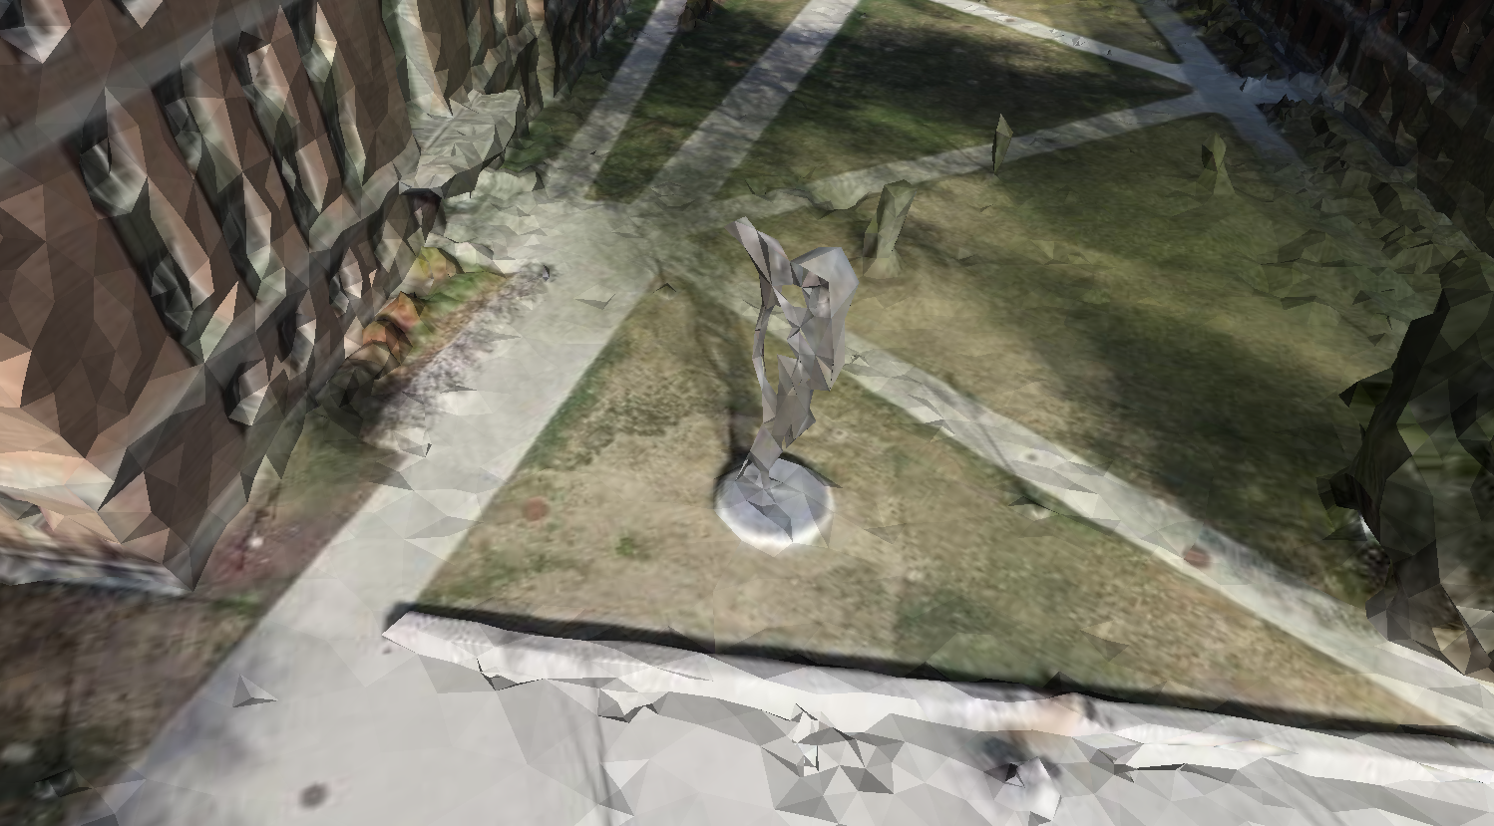
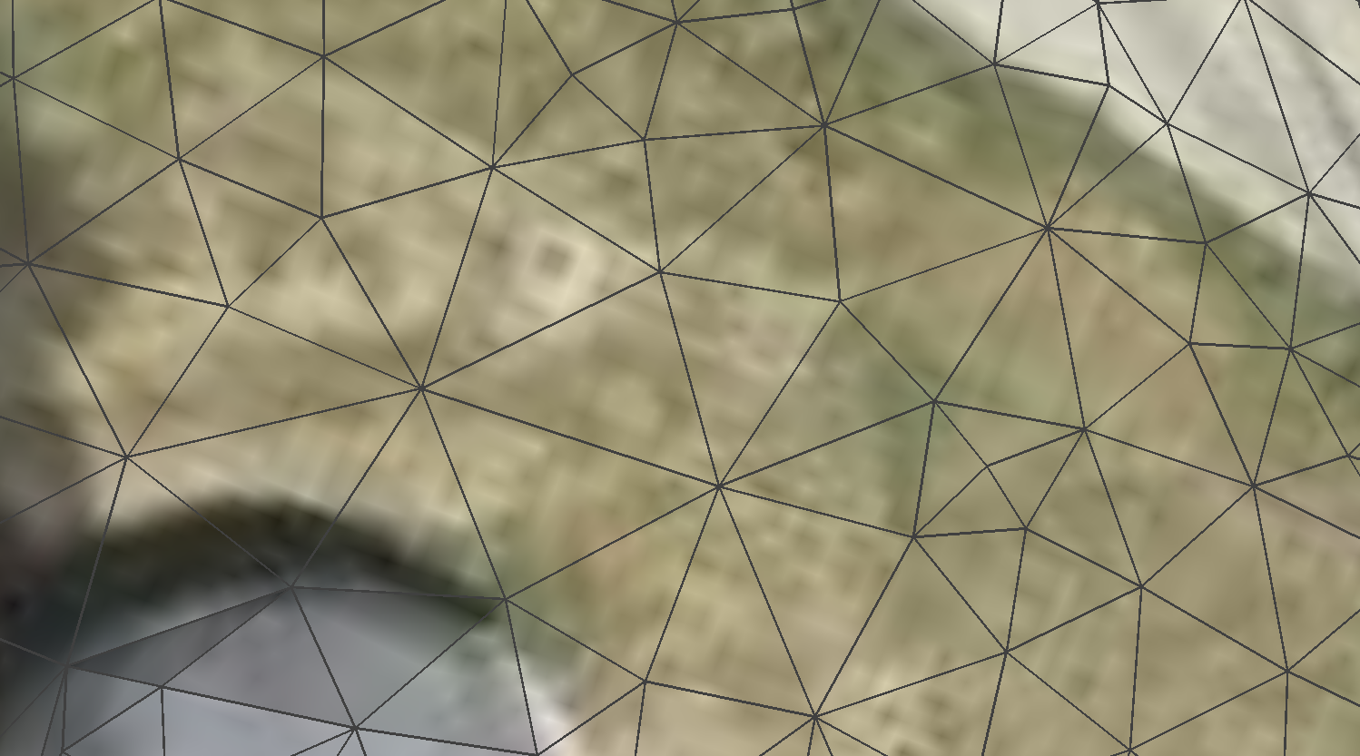
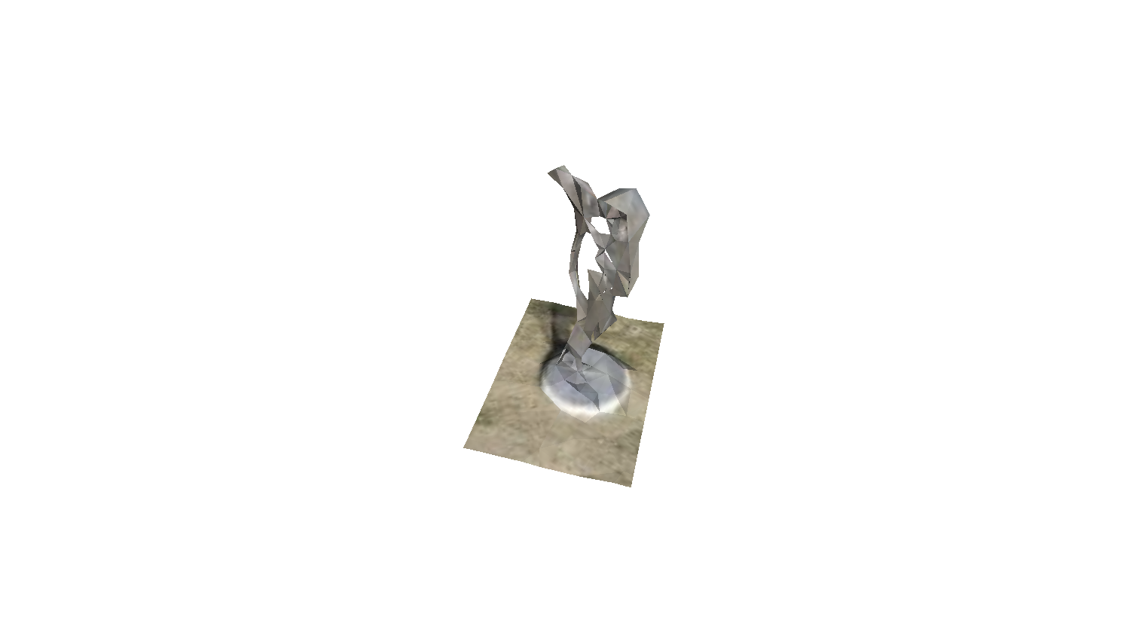
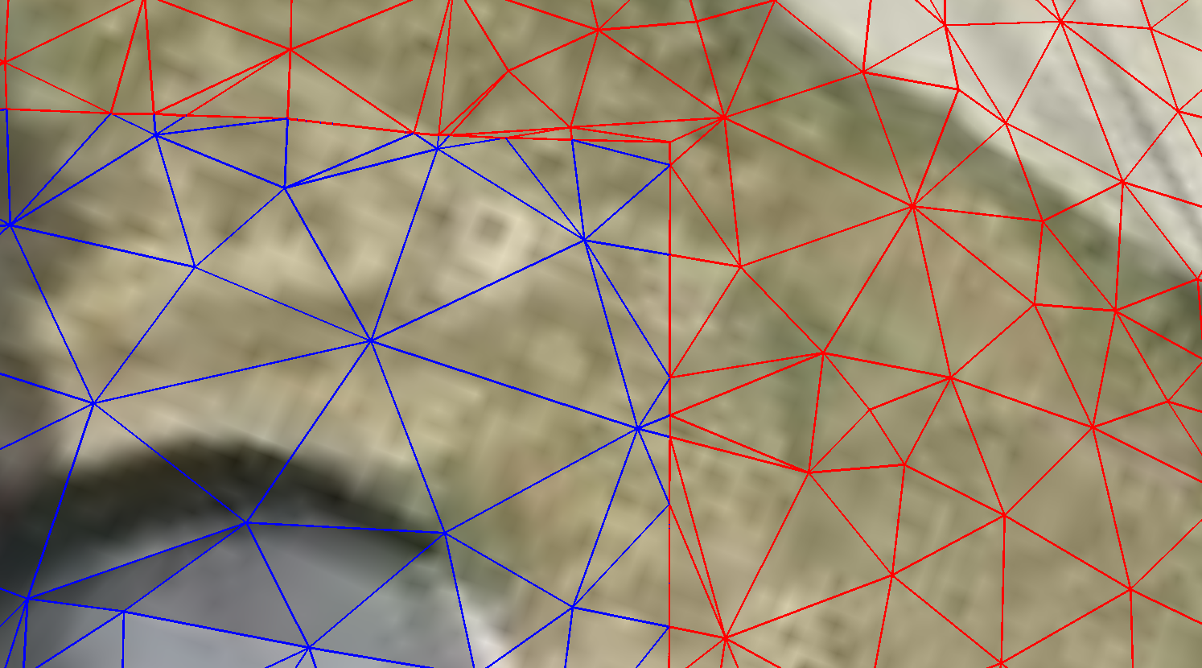
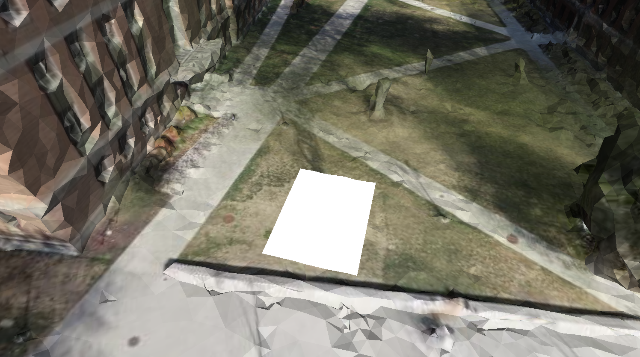
Outside
Inside

Slide 2
Outside
Inside

Slide 3
Out
Out
In
In
Step1: Identity intersection points
(6 intersection types)
Step2: Triangulation

